Slide 1
Image based breed recognition for cattle and buffaloes of India
CSE7302 – University Project
Batch Number: COM_10
Under the Supervision of,
Dr./Mr./Ms./Prof. Murali Parameswaran
Professor / Associate Professor / Assistant Professor
School of Computer Science and Engineering
Presidency University
Student Name | Roll Number
AMISHA | 20221COM0170
KAVYA D K | 20221COM0179
Name of the Program: Computer Engineering
Name of the HoD: Dr.Gopal krishn shyam
Name of the Program Project Coordinator: Smitha Guddin
Name of the School Project Coordinators: Dr. Sampath A K , Dr. Geetha A

Slide 2
Problem Statement Number: SIH25004
Organization: Presidency University
Category : Software
Problem Description: - The manual identification of cattle and buffalo breeds in India is time-consuming, error-prone, and highly dependent on expert knowledge. Due to variations in appearance, lighting, and image quality, traditional methods are inefficient and inconsistent. Hence, there is a need for an automated image-based breed recognition system using deep learning techniques to accurately identify Indian cattle and buffalo breeds from images.

Slide 3
Content
Problem Statement
Objectives
Background and Related work for title Selection
Proposed System
Methodology
Software Requirements
Git-hub Link
Timeline of the project
References

Slide 4
Problem Statement:
The identification of cattle and buffalo breeds in India is traditionally performed through manual observation, which is time-consuming, error-prone, and requires expert knowledge. Variations in animal appearance, image quality, and environmental conditions further reduce accuracy. This project aims to develop an automated image-based breed recognition system using deep learning techniques to accurately classify Indian cattle and buffalo breeds from images.

Slide 5
Abstract
The project Image-Based Breed Recognition for Cattle uses deep learning techniques to automatically identify cattle breeds from images. A Convolutional Neural Network (CNN) model is trained on a dataset of labeled cattle images after preprocessing steps such as resizing and normalization. The model learns important visual features and classifies the breed accurately. This system reduces manual effort and human error in breed identification. It provides a fast and efficient solution for livestock management using artificial intelligence.

Slide 6
What is CNN?
A Convolutional Neural Network (CNN) is a type of deep learning algorithm mainly used for image recognition and classification.
Why CNN is Used?
Image classification
Face recognition
Object detection
Medical image analysis
Breed recognition

Slide 7
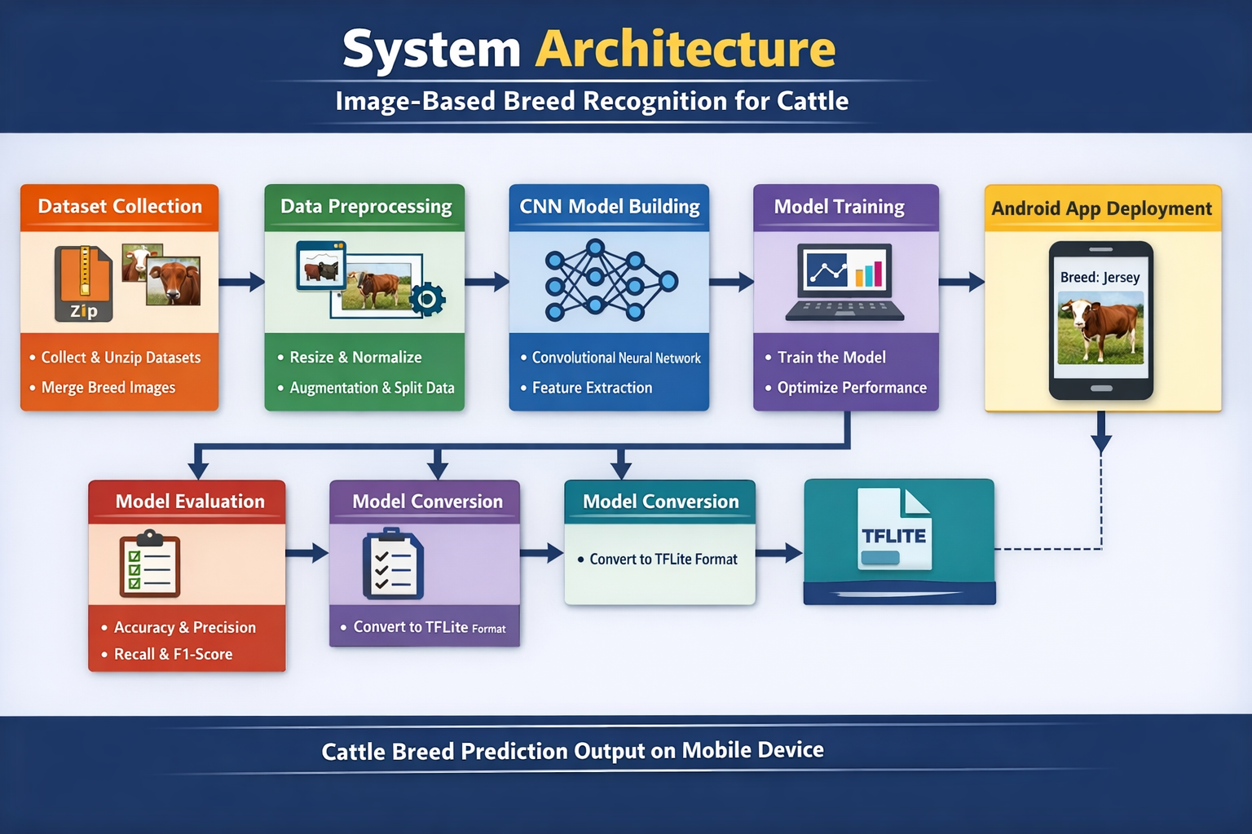
Architecture

Slide 8
1️⃣ Dataset Collection
Collected two cattle image datasets.
Datasets were downloaded in ZIP format.
Unzipped both datasets.
Merged them into one final dataset.
Organized images breed-wise in separate folders.

Slide 9
Model Selection:
Use a Convolutional Neural Network (CNN) or transfer learning models such as VGG16, ResNet, or MobileNet for feature extraction.
Model Training:
Train the model using labeled images and optimize performance using appropriate loss functions and optimizers.
Breed Classification:
Classify the input image into the corresponding cattle or buffalo breed using a softmax output layer.

Slide 10
Model Evaluation:
Evaluate system performance using metrics such as accuracy, precision, recall, and confusion matrix.
Prediction Output:
Display the predicted breed name with confidence score as the final output.

Slide 11
Software Requirements:
Operating System:
Windows / Linux / macOS
2. Programming Language:
Python 3.x
3. Development Environment:
Jupyter Notebook / Google Colab / VS Code / PyCharm
4. Deep Learning Framework:
TensorFlow with Keras / PyTorch

Slide 12
5. Image Processing Library: OpenCV
6. Supporting Libraries: NumPy, Pandas, Matplotlib, Scikit-learn
7. Dataset Source: Kaggle / Government livestock portals / Custom collected images

Slide 13
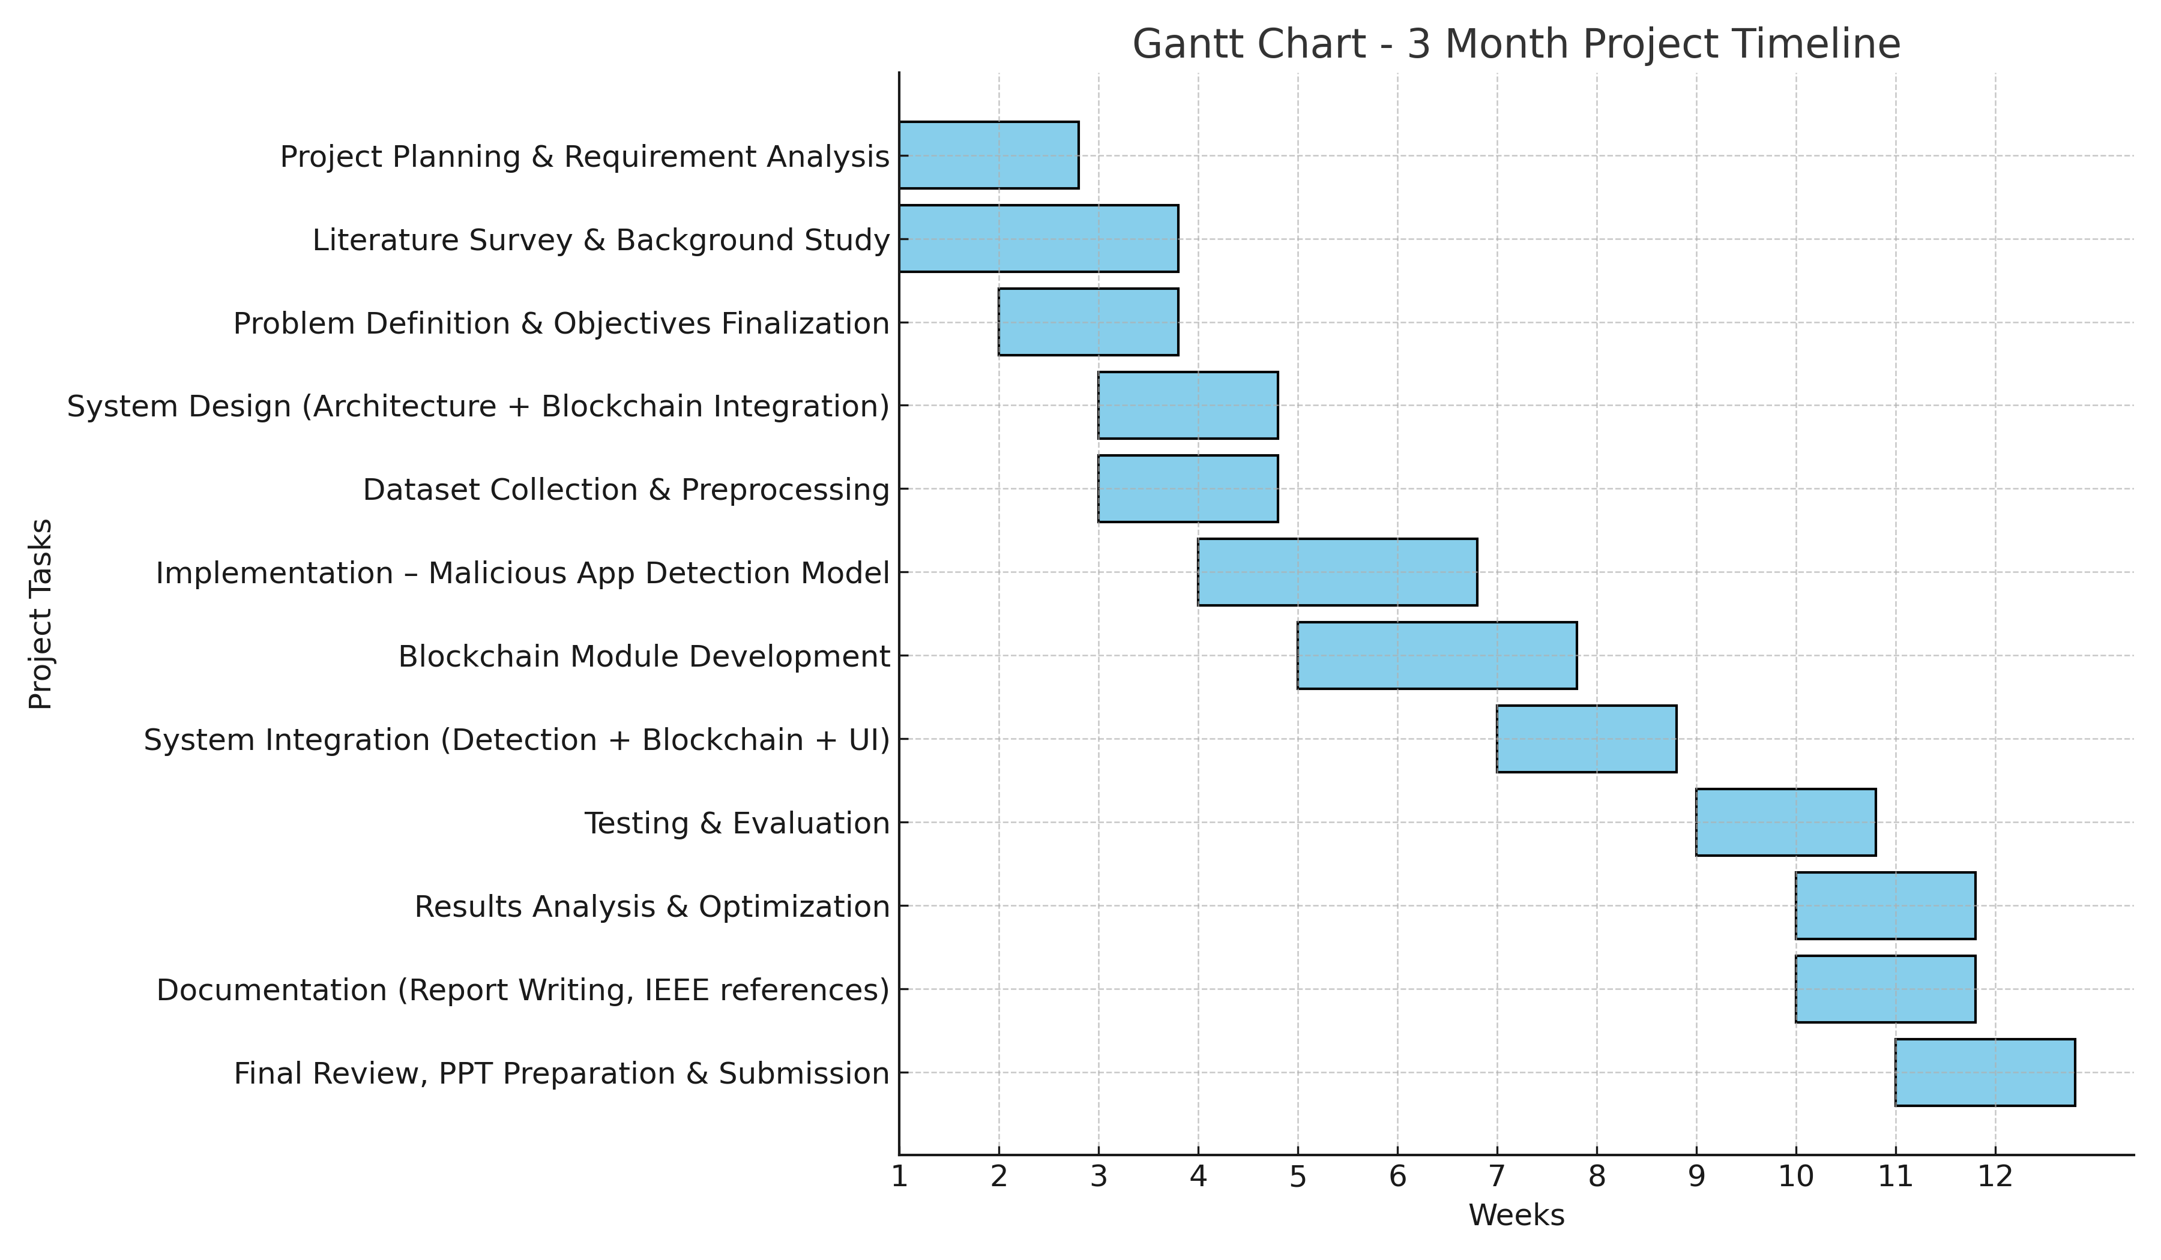
Timeline of the Project (Gantt Chart)

Slide 14
References (IEEE Paper format)
A. B. Valsang and A. Keshi, “Image Based Breed Recognition for Cattle and Buffaloes Using AI,” Int. J. Innov. Res. Technol., vol. 12, no. 8, Jan. 2026.
H. Gupta, P. Jindal, O. P. Verma, and R. K. Arya, “Computer Vision-Based Approach for Automatic Detection of Dairy Cow Breed,” Electronics, vol. 11, no. 22, p. 3791, 2022.
Y. Pan et al., “Identification of Buffalo Breeds Using Self-Activated-Based Improved Convolutional Neural Networks,” Agriculture, MDPI, 2022.
A. Ait Achour and A. Mourhir, “Automated Recognition of Cattle’s Breed Through Computer Vision,” in Proc. 6th Int. Conf. Intelligent Computing in Data Sciences (ICDS), 2024,

Slide 15


